Slide 1

Parts of Speech Tagging
with
Natural language Processing (NLP)
ONUBA CHIBUIKE WINNER*
* onubawinner042@gmail.com

Slide 2
1
INTRODUCTION
Part of speech tagging, also known as POS tagging or word class tagging, is the process of assigning a grammatical category to each word in a text, such as noun, verb, adjective, adverb, etc.
For example,
In the sentence "She likes to read books", the POS tags are:
She - pronoun
likes - verb
to - preposition
read - verb
books - noun
POS tagging is useful for many downstream NLP applications, such as syntactic parsing, semantic analysis, information extraction, machine translation, sentiment analysis, and more. By knowing the POS tags of words, we can better understand the structure and meaning of sentences, and perform more accurate and efficient processing.

Slide 3
2
APPLICATIONS
With POS tagging, NLP algorithms can:
🔰 Enhance Text Understanding: By identifying the roles of words in a sentence, machines can grasp context more accurately, leading to better comprehension of human language.
🔰 Improve Search & Information Retrieval: POS tagging enables more precise indexing and retrieval of information, making search engines smarter and more efficient.
🔰 Facilitate Sentiment Analysis: Understanding the grammatical structure helps in extracting sentiment from text, empowering businesses to gauge customer opinions more effectively.
🔰 Enable Machine Translation: Accurate POS tagging is crucial for translating text between languages, ensuring grammatical correctness and preserving meaning.
🔰 Support Text Summarization & Generation: POS tagging aids in identifying key information in a text, facilitating summarization and generation of concise, coherent content.

Slide 4
3
WORKFLOW
QUICK FOX JUMPS
TOKENIZER
Divide the input text into discrete tokens
“QUICK” “FOX”
“JUMPS”
These models provide a foundation for understanding a language’s grammatical structure
Language Models (e.g., NLTK or SpaCy)
TAGGING
“QUICK” ➡️Adjective (JJ)
“FOX” ➡️Noun (NN)
“JUMPS” ➡️Verb (VBZ)

Slide 5
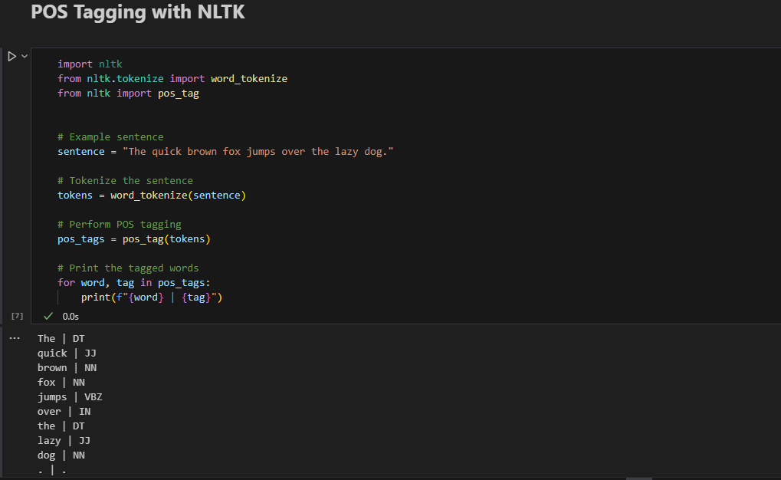
4
There are different methods and tools for POS tagging, ranging from rule-based systems to statistical models to neural networks. Some of the popular POS taggers are NLTK, spaCy, Stanford CoreNLP, and Transformers. Each of these tools has its own advantages and disadvantages, such as speed, accuracy, coverage, and language support.
NLTK
NLTK is a widely used library for NLP, which provides a simple interface for POS tagging. To use NLTK, we need to import the library, tokenize the sentence, and apply the `pos_tag` function. The output is a list of tuples, where each tuple contains a word and its corresponding POS tag.

Slide 6
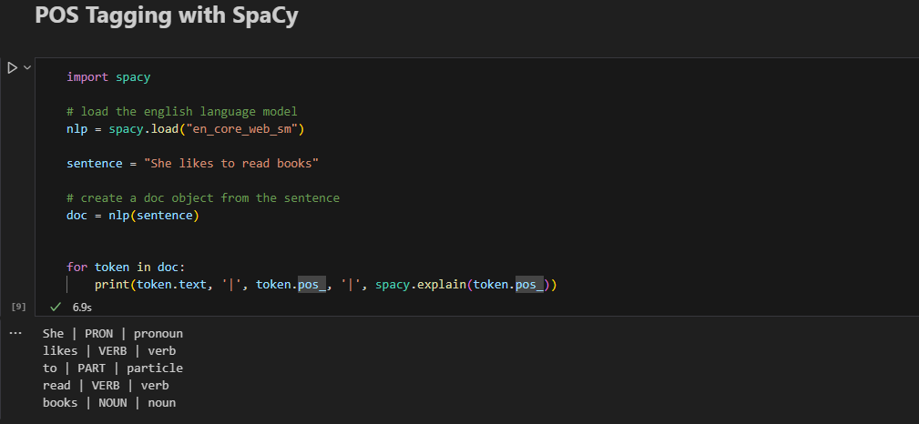
5
SPACY
spaCy is another popular library for NLP, which offers a fast and accurate POS tagger. To use spaCy, we need to import the spacy library, load a language model, and create a Doc object from the sentence. The output is an iterable of Token objects, which have attributes such as text and pos_.
The language model in this case is the pretrained English model

Slide 7
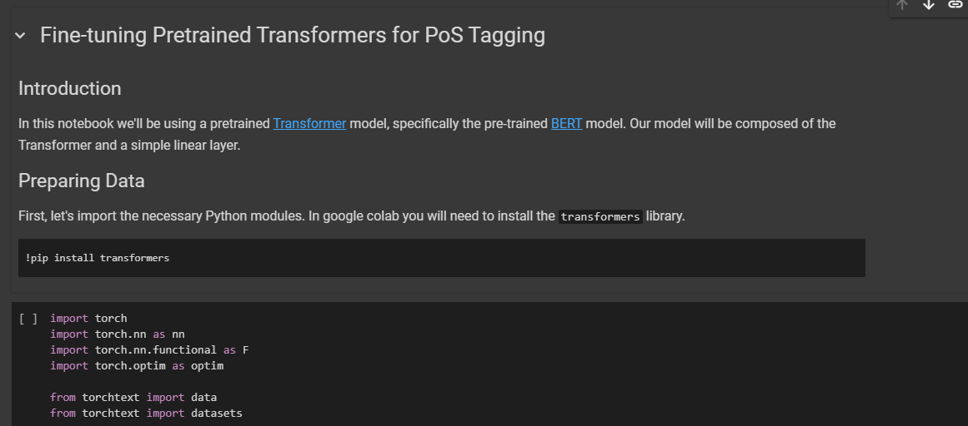
6
Transformers
Transformers is a library for NLP that provides easy access to pre-trained models for various NLP tasks, such as POS tagging. To use Transformers, we need to import the library, load a pipeline object, and pass the sentence as an argument. The output is a list of dictionaries, where each dictionary contains a word and its corresponding POS tag.
View notebook here

Slide 8
7
Method | Advantage
NLTK | Simple and easy to use, widely adopted, supports many languages and tag sets
spaCy | Fast and accurate, integrates well with other NLP components, provides rich linguistic features
Stanford CoreNLP | Comprehensive and robust, covers a wide range of NLP tasks, offers high-quality annotations
Transformers | Powerful and versatile, provides access to pre-trained models, supports various NLP tasks

